Slide 1
PERSONAL FITNESS LESSON #7
The Importance of Living a Healthy Lifestyle

Slide 2
Why is it good to be physically fit?
Metabolic Health
Cancer Risk
Bone Strength
Mental Health
Longevity
Boost in self-esteem

Slide 3
Metabolic health
Metabolic issues→ Type 2 diabetes and metabolic syndrome
If you are more physically fit then these tend to be avoided
If one has a metabolic syndrome
Some or all of these problems arise
High blood sugar, high blood pressure, high triglycerides (fat in the blood), excess belly fat and low high-density lipoprotein “HDL” (good cholesterol)
How to prevent these health problems:
Exercising regularly

Slide 4
Cancer risk
Fit people have a lower risk of developing certain cancers
Colon cancer in both men and women
Breast cancer in women
Other cancers that could potentially be avoided by staying fit
Endometrial cancer in women
Lung Cancer in men and women
“Regular exercise leads to changes in the body (like less inflammation, better immune function, and higher levels of natural antioxidants) that reduce the risk of cancer.”- Harvard University

Slide 5
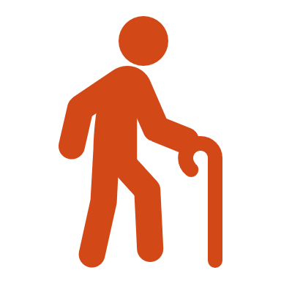
Bone strength
Weight-bearing physical activity causes new bone tissue to form, and this makes bones stronger
Osteoporosis→ a condition where bones become more fragile and fractures are more likely
This can also run in a family
High impact weight-bearing exercises and low impact weight-bearing exercises can help keep bones strong and safe
This can be before an injury or after

Slide 6
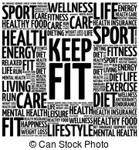
Mental health
Exercise makes you feel good because it releases chemicals like endorphins and serotonin that improve your mood. ... If you exercise regularly , it can reduce your stress and symptoms of mental health conditions like depression and anxiety, and help with recovery from mental health issues.

Slide 7
LONGEVITY
Exercise Boosts Life Expectancy, Study Finds. Regular, moderate physical activity such as brisk walking can increase life expectancy by several years, even for people who are overweight, a new large study shows.
“Keeping fit is one of the most important things you can do to increase your longevity. People who are active for about 7 hours a week, have about 40 percent less chance of dying early than those who are more sedentary.” – CDC
In addition, fit older people are generally less likely to suffer falls or have issues affecting everyday movement and activities than those who are less fit.

Slide 8
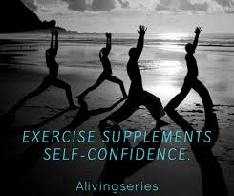
Boost in self-esteem
Who wouldn’t want to have better self-confidence and self-esteem?
While you're boosting your energy levels, oxygen capacity, muscle tone and general fitness, a side benefit is an increase in self-esteem. Just the success of creating an exercise plan and sticking to it allows you to enjoy a sense of achievement.
You are proud of yourself!

Slide 9
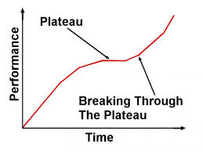
I plateaued in my training But what does that mean?
When applied to an exercise program, the term “plateau” refers to a sudden and dramatic decrease in the noticeable results of your regular workouts. This can manifest itself in both strength and cardiovascular training, as well is in weight loss.
It lasts for a period time in which the body stops responding to the training and nutrition
It doesn’t last forever; especially when you change it up again!

Slide 10
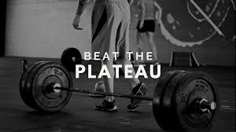
What to do if you hit that plateau in strength training?
Consider switching things up
Modify your sets and reps
Change up the tempo of your exercises
Experiment with different exercises
Experiment with variable resistance (such as bands or chains)
Take time off and restart
Make sure you are getting enough sleep

Slide 11
What to do if you hit that plateau in your weight loss program?
Reassess your habits. Look back at your food and activity records. Make sure you haven't loosened the rules, letting yourself get by with larger portions or less exercise. Research suggests that off-and-on loosening of rules contributes to plateaus.
Cut more calories. Further cut your daily calories, provided this doesn't put you below 1,200 calories. Fewer than 1,200 calories a day may not be enough to keep you from constant hunger, which increases your risk of overeating.
Eat more healthy fats, increase your protein, drink more water
Rev up your workout. Most people should exercise 30 minutes a day, nearly every day of the week. But people trying to lose weight should exercise more often than that or increase the intensity of exercise to burn more calories. Adding exercises such as weightlifting to increase your muscle mass will help you burn more calories.
Pack more activity into your day. Think outside the gym. Increase your general physical activity throughout the day by walking more and using your car less, or try doing more yardwork or vigorous spring cleaning. Any physical activity will help you burn more calories.

Slide 12
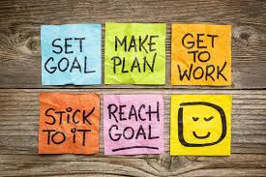
How can you stick with your fitness plan?
Do it for yourself
Take baby steps
Hang tough
Don’t be your own drill sergeant
Bring a friend
Put the time in, but it is okay if it is broken up
Give yourself time to get used to it
Live in the present
Keep it realistic with your goals and what your body can do
Change it up
Track your progress

Slide 13
Make your journey about you!
Ask yourself…
What are YOU trying to achieve?
What do YOU want to get out of being physically active?
What motivated YOU?
What makes YOU feel good about yourself?
You should never be on this journey or make a goal for someone else… this is about you and only you!

Slide 14
Fitness is going to look different for everyone. It shouldn’t just be something done today.. Make it a lifestyle!

